Slide 1


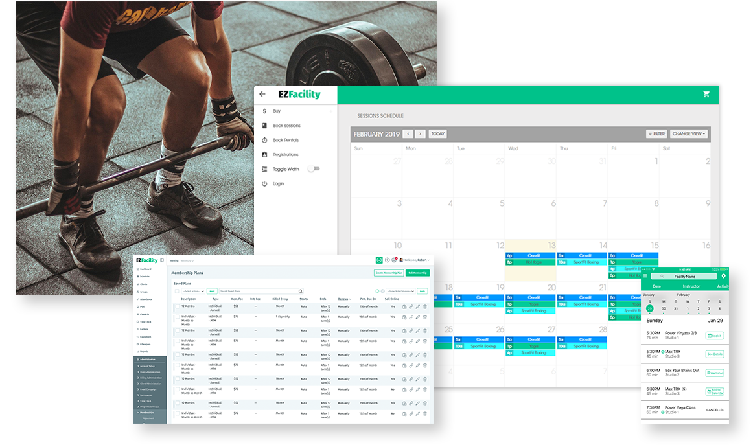


Jim Buddy
By: Larissa Vieira and Diana Romero
Jim will help you track your attendance at the gym!
https://github.com/ksu-is/Gymattendancetracker-

